Slide 1
CHAPTER 6 GRAPHS
All the programs in this file are selected from
Ellis Horowitz, Sartaj Sahni, and Susan Anderson-Freed
“Fundamentals of Data Structures in C”,
Computer Science Press, 1992.

Slide 2
Definition
A graph G consists of two sets
a finite, nonempty set of vertices V(G)
a finite, possible empty set of edges E(G)
G(V,E) represents a graph
An undirected graph is one in which the pair of vertices in a edge is unordered, (v0, v1) = (v1,v0)
A directed graph is one in which each edge is a directed pair of vertices, <v0, v1> != <v1,v0>
tail
head

Slide 3
Examples for Graph
0
0
0
1
2
1
2
1
3
3
4
5
6
G1
2
G2
complete graph
incomplete graph
G3
V(G1)={0,1,2,3} E(G1)={(0,1),(0,2),(0,3),(1,2),(1,3),(2,3)}
V(G2)={0,1,2,3,4,5,6} E(G2)={(0,1),(0,2),(1,3),(1,4),(2,5),(2,6)}
V(G3)={0,1,2} E(G3)={<0,1>,<1,0>,<1,2>}
complete undirected graph: n(n-1)/2 edges
complete directed graph: n(n-1) edges

Slide 4
Complete Graph
A complete graph is a graph that has the maximum number of edges
for undirected graph with n vertices, the maximum number of edges is n(n-1)/2
for directed graph with n vertices, the maximum number of edges is n(n-1)
example: G1 is a complete graph

Slide 5
Adjacent and Incident
If (v0, v1) is an edge in an undirected graph,
v0 and v1 are adjacent
The edge (v0, v1) is incident on vertices v0 and v1
If <v0, v1> is an edge in a directed graph
v0 is adjacent to v1, and v1 is adjacent from v0
The edge <v0, v1> is incident on v0 and v1

Slide 6
Figure 6.3
*Figure 6.3:Example of a graph with feedback loops and a
multigraph (p.260)
0
0
2
1
3
1
2
self edge
multigraph:
multiple occurrences
of the same edge
(a)
(b)

Slide 7
Subgraph and Path
A subgraph of G is a graph G’ such that V(G’) is a subset of V(G) and E(G’) is a subset of E(G)
A path from vertex vp to vertex vq in a graph G, is a sequence of vertices, vp, vi1, vi2, ..., vin, vq, such that (vp, vi1), (vi1, vi2), ..., (vin, vq) are edges in an undirected graph
The length of a path is the number of edges on it

Slide 8
Figure 6.4: subgraphs of G₁ and G₃ (p.261)
0
0
0
1
2
0
1
2
1
2
3
1
2
3
3
G1
(i) (ii) (iii) (iv)
(a) Some of the subgraph of G₁
0
0
0
0
0
單一
1
1
1
1
分開
2
2
2
(i) (ii) (iii) (iv)
(b) Some of the subgraph of G₃
G3

Slide 9
Simple Path and Style
A simple path is a path in which all vertices, except possibly the first and the last, are distinct
A cycle is a simple path in which the first and the last vertices are the same
In an undirected graph G, two vertices, v0 and v1, are connected if there is a path in G from v0 to v1
An undirected graph is connected if, for every pair of distinct vertices vi, vj, there is a path from vi to vj

Slide 10
connected
0
0
1
2
1
2
3
3
4
5
6
G1
G2
tree (acyclic graph)

Slide 11
Connected Component
A connected component of an undirected graph is a maximal connected subgraph.
A tree is a graph that is connected and acyclic.
A directed graph is strongly connected if there is a directed path from vi to vj and also from vj to vi.
A strongly connected component is a maximal subgraph that is strongly connected.

Slide 12
*Figure 6.5: A graph with two connected components (p.262)
connected component (maximal connected subgraph)
H₁
0
H₂
4
2
1
5
3
6
7
G₄ (not connected)

Slide 13
*Figure 6.6: Strongly connected components of G₃ (p.262)
strongly connected component
(maximal strongly connected subgraph)
not strongly connected
0
0
2
1
1
2
G3

Slide 14
Degree
The degree of a vertex is the number of edges incident to that vertex
For directed graph,
the in-degree of a vertex v is the number of edges that have v as the head
the out-degree of a vertex v is the number of edges that have v as the tail
if di is the degree of a vertex i in a graph G with n vertices and e edges, the number of edges is

Slide 15
undirected graph
degree
3
0
0
2
1
2
3
1
2
3
3
3
3
4
5
6
3
3
1
G1
1
G2
1
1
0
in:1, out: 1
directed graph
in-degree
out-degree
1
in: 1, out: 2
2
in: 1, out: 0
G3

Slide 16
Graph Representations
Adjacency Matrix
Adjacency Lists
Adjacency Multilists

Slide 17
Adjacency Matrix
Let G=(V,E) be a graph with n vertices.
The adjacency matrix of G is a two-dimensional n by n array, say adj_mat
If the edge (vi, vj) is in E(G), adj_mat[i][j]=1
If there is no such edge in E(G), adj_mat[i][j]=0
The adjacency matrix for an undirected graph is symmetric; the adjacency matrix for a digraph need not be symmetric

Slide 18
Examples for Adjacency Matrix
0
0
4
0
2
1
5
1
2
3
6
3
1
7
2
G2
G1
symmetric
undirected: n²/2
directed: n²
G4

Slide 19
Merits of Adjacency Matrix
From the adjacency matrix, to determine the connection of vertices is easy
The degree of a vertex is
For a digraph, the row sum is the out_degree, while the column sum is the in_degree

Slide 20
Data Structures for Adjacency Lists
Each row in adjacency matrix is represented as an adjacency list.
#define MAX_VERTICES 50
typedef struct node *node_pointer;
typedef struct node {
int vertex;
struct node *link;
};
node_pointer graph[MAX_VERTICES];
int n=0; /* vertices currently in use */

Slide 21
0
0
4
2
1
5
1
2
3
6
3
7
0
1
2
3
1
2
3
0
1
2
3
4
5
6
7
1
2
0
2
3
0
3
0
1
3
0
3
0
1
2
1
2
G1
0
5
4
6
0
1
2
1
5
7
0
2
1
6
G3
G4
2
An undirected graph with n vertices and e edges ==> n head nodes and 2e list nodes

Slide 22
Interesting Operations
degree of a vertex in an undirected graph
# of nodes in adjacency list
# of edges in a graph
determined in O(n+e)
out-degree of a vertex in a directed graph
# of nodes in its adjacency list
in-degree of a vertex in a directed graph
traverse the whole data structure

Slide 23
Compact Representation
0
4
node[0] … node[n-1]: starting point for vertices
node[n]: n+2e+1
node[n+1] … node[n+2e]: head node of edge
2
1
5
3
6
7
0
4
5
1
6
2
7
3

Slide 24
Figure 6.10: Inverse adjacency list for G₃
0
0
1
2
•
•
•
1 NULL
1
0 NULL
1 NULL
2
Determine in-degree of a vertex in a fast way.

Slide 25
Figure 6.11: Alternate node structure for adjacency lists (p.267)
tail head column link for head row link for tail

Slide 26
Figure 6.12: Orthogonal representation for graph G₃(p.268)
0
1
2
0
0 1 NULL NULL
1
1 0 NULL
1 2 NULL NULL
0
2 NULL
1
2

Slide 27
Figure 6.13:Alternate order adjacency list for G₁ (p.268)
Order is of no significance.
headnodes vertax link
0
•
3 •
1 •
2 NULL
1
•
2 •
0 •
3 NULL
2
•
3 •
0 •
1 NULL
3
•
2 •
1 •
0 NULL
0
1
2
3

Slide 28
Adjacency Multilists
An edge in an undirected graph is represented by two nodes in adjacency list representation.
Adjacency Multilists
lists in which nodes may be shared among several lists. (an edge is shared by two different paths)
marked vertex1 vertex2 path1 path2

Slide 29
Example for Adjacency Multlists
Lists: vertex 0: M1->M2->M3, vertex 1: M1->M4->M5
vertex 2: M2->M4->M6, vertex 3: M3->M5->M6
(1,0)
0
1
2
3
N1
N2
N3
N4
N5
N6
0 1 N2 N4
edge (0,1)
edge (0,2)
edge (0,3)
edge (1,2)
edge (1,3)
edge (2,3)
(2,0)
0 2 N3 N4
(3,0)
0 3 N5
(2,1)
1 2 N5 N6
0
(3,1)
1 3 N6
1
2
(3,2)
2 3
3
six edges

Slide 30
Adjacency Multilists
typedef struct edge *edge_pointer;
typedef struct edge {
short int marked;
int vertex1, vertex2;
edge_pointer path1, path2;
};
edge_pointer graph[MAX_VERTICES];
marked vertex1 vertex2 path1 path2

Slide 31
Some Graph Operations
Traversal Given G=(V,E) and vertex v, find all w∈V, such that w connects v.
Depth First Search (DFS) preorder tree traversal
Breadth First Search (BFS) level order tree traversal
Connected Components
Spanning Trees

Slide 32
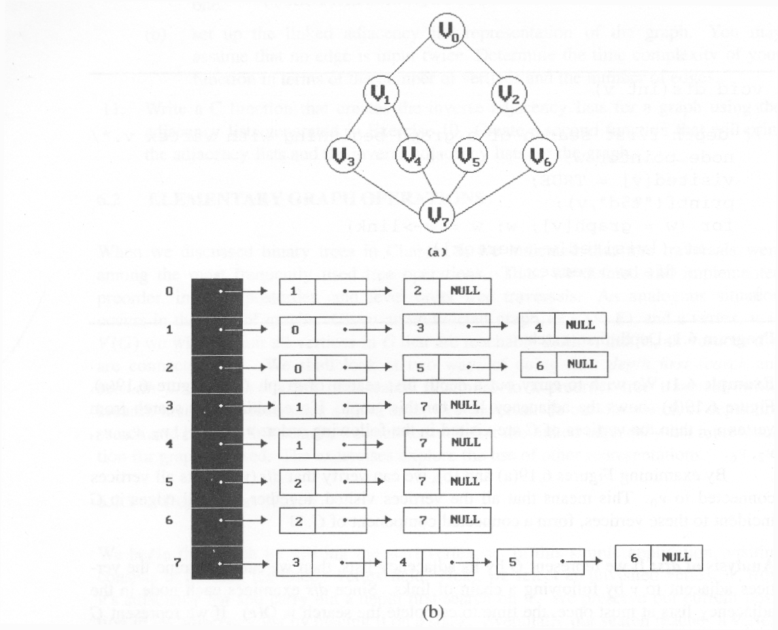
*Figure 6.19:Graph G and its adjacency lists (p.274)
depth first search: v0, v1, v3, v7, v4, v5, v2, v6
breadth first search: v0, v1, v2, v3, v4, v5, v6, v7

Slide 33
Depth First Search
#define FALSE 0
#define TRUE 1
short int visited[MAX_VERTICES];
void dfs(int v)
{
node_pointer w;
visited[v]= TRUE;
printf(“%5d”, v);
for (w=graph[v]; w; w=w->link)
if (!visited[w->vertex])
dfs(w->vertex);
}
Data structure
adjacency list: O(e)
adjacency matrix: O(n²)

Slide 34
Breadth First Search
typedef struct queue *queue_pointer;
typedef struct queue {
int vertex;
queue_pointer link;
};
void addq(queue_pointer *, queue_pointer *, int);
int deleteq(queue_pointer *);

Slide 35
Breadth First Search (Continued)
void bfs(int v)
{
node_pointer w;
queue_pointer front, rear;
front = rear = NULL;
printf(“%5d”, v);
visited[v] = TRUE;
addq(&front, &rear, v);
adjacency list: O(e)
adjacency matrix: O(n²)

Slide 36
while (front) {
v= deleteq(&front);
for (w=graph[v]; w; w=w->link)
if (!visited[w->vertex]) {
printf(“%5d”, w->vertex);
addq(&front, &rear, w->vertex);
visited[w->vertex] = TRUE;
}
}
}

Slide 37
Connected Components
void connected(void)
{
for (i=0; i<n; i++) {
if (!visited[i]) {
dfs(i);
printf(“\n”);
}
}
}
adjacency list: O(n+e)
adjacency matrix: O(n²)

Slide 38
Spanning Trees
When graph G is connected, a depth first or breadth first search starting at any vertex will visit all vertices in G
A spanning tree is any tree that consists solely of edges in G and that includes all the vertices
E(G): T (tree edges) + N (nontree edges) where T: set of edges used during search N: set of remaining edges

Slide 39
Examples of Spanning Tree
0
0
0
0
1
2
1
2
1
2
1
2
3
3
3
3
G1
Possible spanning trees

Slide 40
Spanning Trees
Either dfs or bfs can be used to create a spanning tree
When dfs is used, the resulting spanning tree is known as a depth first spanning tree
When bfs is used, the resulting spanning tree is known as a breadth first spanning tree
While adding a nontree edge into any spanning tree, this will create a cycle

Slide 41
DFS VS BFS Spanning Tree
0
0
0
1
2
1
2
1
2
3
4
5
6
3
4
5
6
3
4
5
6
7
7
nontree edge
cycle
7
DFS Spanning
BFS Spanning

Slide 42
A spanning tree is a minimal subgraph, G’, of G
such that V(G’)=V(G) and G’ is connected.
Any connected graph with n vertices must have at least n-1 edges.
A biconnected graph is a connected graph that has
no articulation points.
0
1
2
biconnected graph
3
4
5
6
7

Slide 43
0
8 9
7
1
2
3
5
connected graph
4
6
two connected components
one connected graph
8 9
0
8 9
0
7
7
1
1
2
2
3
5
3
5
4
6
4
6

Slide 44
biconnected component: a maximal connected subgraph H (no subgraph that is both biconnected and properly contains H)
0
8
9
0
8 9
1
7
7
7
1
7
2
1
3
5
2
3
3
5
5
4
6
4
6
biconnected components

Slide 45
Find biconnected component of a connected undirected graph
by depth first spanning tree
nontree
edge
(back edge)
0
3
4 0
9 8 9 8
1 5
nontree
edge
(back edge)
4
5
7 7
3
1
0 5
3 5
2
4
2
6
7
6
2 2
3
1
7
dfn
depth
first
number
8 9
4 6
1 6
0
9
8
Why is cross edge impossible?
(a) depth first spanning tree (b)
If u is an ancestor of v then dfn(u) < dfn(v).

Slide 46
*Figure 6.24: dfn and low values for dfs spanning tree with root =3(p.281)

Slide 47
0
3
*The root of a depth first spanning
tree is an articulation point iff
it has at least two children.
1 5
4
5
2
4
2
6
7
6
*Any other vertex u is an articulation
point iff it has at least one child w
such that we cannot reach an ancestor
of u using a path that consists of
(1) only w (2) descendants of w (3)
single back edge.
3
1
7
8 9
0
9
8
low(u)=min{dfn(u),
min{low(w)|w is a child of u},
min{dfn(w)|(u,w) is a back edge}
u: articulation point
low(child) ≥ dfn(u)

Slide 48
3
1 5
4
5
2
4
2
6
7
6
3
1
7
8 9
0
9
8

Slide 49
*Program 6.5: Initializaiton of dfn and low (p.282)
void init(void) { int i; for (i = 0; i < n; i++) { visited[i] = FALSE; dfn[i] = low[i] = -1; } num = 0; }

Slide 50
*Program 6.4: Determining dfn and low (p.282)
void dfnlow(int u, int v) { /* compute dfn and low while performing a dfs search beginning at vertex u, v is the parent of u (if any) */ node_pointer ptr; int w; dfn[u] = low[u] = num++; for (ptr = graph[u]; ptr; ptr = ptr ->link) { w = ptr ->vertex; if (dfn[w] < 0) { /*w is an unvisited vertex */ dfnlow(w, u); low[u] = MIN2(low[u], low[w]); } else if (w != v) low[u] =MIN2(low[u], dfn[w] ); } }
Initial call: dfn(x,-1)
low[u]=min{dfn(u), …}
v
u
w
v
u
low[u]=min{…, min{low(w)|w is a child of u}, …}
dfn[w]≠0 非第一次，表示藉back edge
X
O
low[u]=min{…,…,min{dfn(w)|(u,w) is a back edge}

Slide 51
*Program 6.6: Biconnected components of a graph (p.283)
void bicon(int u, int v) { /* compute dfn and low, and output the edges of G by their biconnected components , v is the parent ( if any) of the u (if any) in the resulting spanning tree. It is assumed that all entries of dfn[ ] have been initialized to -1, num has been initialized to 0, and the stack has been set to empty */ node_pointer ptr; int w, x, y; dfn[u] = low[u] = num ++; for (ptr = graph[u]; ptr; ptr = ptr->link) { w = ptr ->vertex; if ( v != w && dfn[w] < dfn[u] ) add(&top, u, w); /* add edge to stack */
low[u]=min{dfn(u), …}
(1) dfn[w]=-1 第一次
(2) dfn[w]!=-1非第一次，藉back
edge

Slide 52
if(dfn[w] < 0) {/* w has not been visited */ bicon(w, u); low[u] = MIN2(low[u], low[w]); if (low[w] >= dfn[u] ){ articulation point printf(“New biconnected component: “); do { /* delete edge from stack */ delete(&top, &x, &y); printf(“ <%d, %d>” , x, y); } while (!(( x = = u) && (y = = w))); printf(“\n”); } } else if (w != v) low[u] = MIN2(low[u], dfn[w]); } }
low[u]=min{…, min{low(w)|w is a child of u}, …}
low[u]=min{…, …, min{dfn(w)|(u,w) is a back edge}}

Slide 53
Minimum Cost Spanning Tree
The cost of a spanning tree of a weighted undirected graph is the sum of the costs of the edges in the spanning tree
A minimum cost spanning tree is a spanning tree of least cost
Three different algorithms can be used
Kruskal
Prim
Sollin
Select n-1 edges from a weighted graph
of n vertices with minimum cost.

Slide 54
Greedy Strategy
An optimal solution is constructed in stages
At each stage, the best decision is made at this time
Since this decision cannot be changed later, we make sure that the decision will result in a feasible solution
Typically, the selection of an item at each stage is based on a least cost or a highest profit criterion

Slide 55
Kruskal’s Idea
Build a minimum cost spanning tree T by adding edges to T one at a time
Select the edges for inclusion in T in nondecreasing order of the cost
An edge is added to T if it does not form a cycle
Since G is connected and has n > 0 vertices, exactly n-1 edges will be selected

Slide 56
Examples for Kruskal’s Algorithm
10
0 5
2 3
1 6
1 2
3 6
3 4
4 6
4 5
0 1
12
14
0
0
0
28
16
1
1
10
1
10
14
16
18
6
2
5
6
2
5
6
2
5
24
22
25
18
12
4
4
4
22
3
3
3
24
25
6/9
28

Slide 57
0 5
2 3
1 6
1 2
3 6
3 4
4 6
4 5
0 1
10
12
14
16
0
0
0
10
1
10
1
10
1
18
14
14
16
22
5
6
2
5
6
2
5
6
2
12
12
12
24
4
4
4
3
3
3
25
28
+
3 6
cycle

Slide 58
0 5
2 3
1 6
1 2
3 6
3 4
4 6
4 5
0 1
10
12
14
0
0
16
10
1
10
1
18
14
16
14
16
5
6
2
5
6
2
22
25
12
12
4
4
24
22
+
4 6
22
3
3
25
cycle
cost = 10 +25+22+12+16+14
28

Slide 59
Kruskal’s Algorithm
目標：取出n-1條edges
T= {};
while (T contains less than n-1 edges && E is not empty) {
choose a least cost edge (v,w) from E;
delete (v,w) from E;
if ((v,w) does not create a cycle in T)
add (v,w) to T
else discard (v,w);
}
if (T contains fewer than n-1 edges)
printf(“No spanning tree\n”);
min heap construction time O(e)
choose and delete O(log e)
find find & union O(log e)
{0,5}, {1,2,3,6}, {4} + edge(3,6) X + edge(3,4) --> {0,5},{1,2,3,4,6}
O(e log e)

Slide 60
Prim’s Algorithm
(tree all the time vs. forest)
T={};
TV={0};
while (T contains fewer than n-1 edges)
{
let (u,v) be a least cost edge such
that and
if (there is no such edge ) break;
add v to TV;
add (u,v) to T;
}
if (T contains fewer than n-1 edges)
printf(“No spanning tree\n”);

Slide 61
Examples for Prim’s Algorithm
0
28
10
1
14
16
5
6
2
24
25
0
18
12
0
0
4
10
1
22
3
1
10
1
10
5
6
2
5
6
2
5
6
2
25
25
4
4
4
3
3
22
3

Slide 62
0
28
10
1
14
16
5
6
2
24
25
18
12
4
22
3
0
0
0
10
1
10
1
10
1
16
14
16
5
6
2
5
6
2
5
6
2
25
25
25
4
12
4
12
4
12
22
3
22
3
22
3

Slide 63
Sollin’s Algorithm
0
28
10
1
14
16
5
6
2
24
25
18
12
4
22
3
0
0
{0,5}
0
25
28
1
1
10
1
5 4
0 1
10
14
14
16
{1,6}
5
6
2
5
6
2
5
6
2
16
28
1 2
1
0
12
4
12
4
4
24
18
6 4
22
6 3
22
3
3
3

Slide 64
*Figure 6.29: Graph and shortest paths from v₀ (p.293)
Single Source All Destinations
Determine the shortest paths from v0 to all the remaining vertices.
45
50 10
path length
1) v0 v2 10
2) v0 v2 v3 25
3) v0 v2 v3 v1 45
4) v0 v4 45
(b)
V₀
V₁
V₄
20 10 15 20 35 30
V₂
15 3
V₃
V₅
(a)

Slide 65
Example for the Shortest Path
Boston
4
1500
San
Francisco
Chicago
Denver
1200
3
250
800
2
1000
1
5
New
York
300
1000
1400
1700
New Orleans
900
0
7
1000
Los Angeles
6
Miami
0 1 2 3 4 5 6 7
0 0
1 300 0
2 1000 800 0
3 1200 0
4 1500 0 250
5 1000 0 900 1400
6 0 1000
7 1700 0
Cost adjacency matrix

Slide 66
(a)
(b)
(c)
4
1500
4
1500
4
250
3
3
5
250
250
5
1000
5
900
6
選5
4到3由1500改成1250
4到6由∞改成1250
4
4
(d)
(f)
4
(e)
3
250
250
1000
250
5
5
7
1400
5
7
1400
7
1400
900
6
1000
900
6
4到7由∞改成1650
選6
4-5-6-7比4-5-7長

Slide 67
(g)
(h)
4
4
3
1200
3
250
2
1000
250
5
1000
7
5
1400
7
1400
900
900
6
6
選3
4到2由∞改成2450
(i)
4
4
2
1200
3
(j)
250
250
1000
0
5
5
7
1400
7
1400
900
6
4到0由∞改成3350
選7

Slide 68
Example for the Shortest Path (Continued)
(b)
(c)
(d)
(a)
(f)
(e)
(h)
(g)
(j)
(i)

Slide 69
Data Structure for SSAD
#define MAX_VERTICES 6
int cost[][MAX_VERTICES]=
{{ 0, 50, 10, 1000, 45, 1000},
{1000, 0, 15, 1000, 10, 1000},
{ 20, 1000, 0, 15, 1000, 1000},
{1000, 20, 1000, 0, 35, 1000},
{1000, 1000, 30, 1000, 0, 1000},
{1000, 1000, 1000, 3, 1000, 0}};
int distance[MAX_VERTICES];
short int found{MAX_VERTICES];
int n = MAX_VERTICES;
adjacency matrix

Slide 70
Single Source All Destinations
void shortestpath(int v, int cost[][MAX_ERXTICES], int distance[], int n, short int found[])
{
int i, u, w;
for (i=0; i<n; i++) {
found[i] = FALSE;
distance[i] = cost[v][i];
}
found[v] = TRUE;
distance[v] = 0;
O(n)

Slide 71
for (i=0; i<n-2; i++) {determine n-1 paths from v
u = choose(distance, n, found);
found[u] = TRUE;
for (w=0; w<n; w++)
if (!found[w])
if (distance[u]+cost[u][w]<distance[w])
distance[w] = distance[u]+cost[u][w];
}
}
與u相連的端點w
O(n²)

Slide 72
All Pairs Shortest Paths
Find the shortest paths between all pairs of vertices.
Solution 1
Apply shortest path n times with each vertex as source. O(n³)
Solution 2
Represent the graph G by its cost adjacency matrix with cost[i][j]
If the edge <i,j> is not in G, the cost[i][j] is set to some sufficiently large number
A[i][j] is the cost of the shortest path form i to j, using only those intermediate vertices with an index <= k

Slide 73
All Pairs Shortest Paths (Continued)
n-1
The cost of the shortest path from i to j is A [i][j], as no vertex in G has an index greater than n-1
A [i][j]=cost[i][j]
Calculate the A, A, A, ..., A from A iteratively
A [i][j]=min{A [i][j], A [i][k]+A [k][j]}, k>=0
-1
0
1
2
n-1
-1
k
k-1
k-1
k-1

Slide 74
Graph with negative cycle
-2
0
1
2
1
1
(a) Directed graph (b) A⁻¹
The length of the shortest path from vertex 0 to vertex 2 is -∝.
0, 1, 0, 1,0, 1, …, 0, 1, 2

Slide 75
Algorithm for All Pairs Shortest Paths
void allcosts(int cost[][MAX_VERTICES],
int distance[][MAX_VERTICES], int n)
{
int i, j, k;
for (i=0; i<n; i++)
for (j=0; j<n; j++) distance[i][j] = cost[i][j];
for (k=0; k<n; k++)
for (i=0; i<n; i++)
for (j=0; j<n; j++)
if (distance[i][k]+distance[k][j] < distance[i][j])
distance[i][j]= distance[i][k]+distance[k][j];
}

Slide 76
* Figure 6.33: Directed graph and its cost matrix (p.299)
6
4
V₀
V1
3 11 2
V₂
(a)Digraph G (b)Cost adjacency matrix for G

Slide 77
A⁻¹
6
4
A⁰
V₀
V1
A⁻¹
3 11 2
0 0
6 4
3 11
V₂
v0
A¹
A²
A⁰
A¹
4 6
0 0
7 2
6 3
2 7
0 0
v1
v2

Slide 78
Transitive Closure
Goal: given a graph with unweighted edges, determine if there is a path from i to j for all i and j.
(1) Require positive path (> 0) lengths.
(2) Require nonnegative path (≥0) lengths.
transitive closure matrix
reflexive transitive closure matrix
0
1
2
3
4
0
1
2
3
4
(a) Digraph G (b) Adjacency matrix A for G
0
1
2
3
4
0
1
2
3
4
cycle
reflexive
(c) transitive closure matrix A⁺ (d) reflexive transitive closure matrix A*
There is a path of length > 0
There is a path of length ≥0

Slide 79
Activity on Vertex (AOV) Network
definition A directed graph in which the vertices represent tasks or activities and the edges represent precedence relations between tasks.
predecessor (successor) vertex i is a predecessor of vertex j iff there is a directed path from i to j. j is a successor of i.
partial order a precedence relation which is both transitive (∀i, j, k, i•j & j•k => i•k ) and irreflexive (∀x ¬x•x).
acylic graph a directed graph with no directed cycles

Slide 80
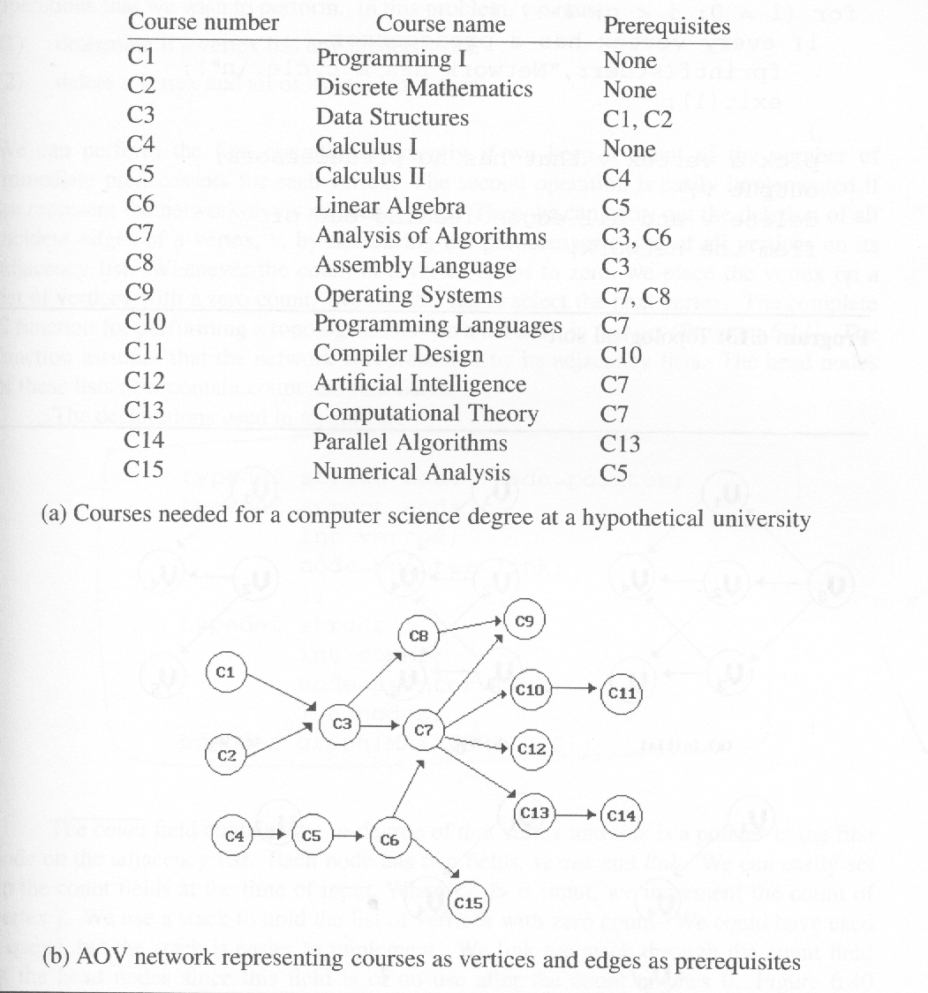
*Figure 6.38: An AOV network (p.305)
Topological order:
linear ordering of vertices
of a graph
∀i, j if i is a predecessor of
j, then i precedes j in the
linear ordering
C1, C2, C4, C5, C3, C6, C8,
C7, C10, C13, C12, C14, C15,
C11, C9
C4, C5, C2, C1, C6, C3, C8,
C15, C7, C9, C10, C11, C13,
C12, C14

Slide 81
*Program 6.13: Topological sort (p.306)
for (i = 0; i <n; i++) { if every vertex has a predecessor { fprintf(stderr, “Network has a cycle. \n “ ); exit(1); } pick a vertex v that has no predecessors; output v; delete v and all edges leading out of v from the network; }

Slide 82
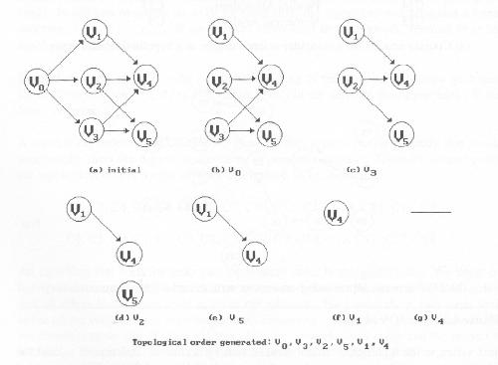
*Figure 6.39:Simulation of Program 6.13 on an AOV network (p.306)
v0 no predecessor
delete v0->v1, v0->v2, v0->v3
v1, v2, v3 no predecessor
select v3
delete v3->v4, v3->v5
select v2
delete v2->v4, v2->v5
select v5
select v1
delete v1->v4

Slide 83
Issues in Data Structure Consideration
Decide whether a vertex has any predecessors.
Each vertex has a count.
Decide a vertex together with all its incident edges.
Adjacency list

Slide 84
*Figure 6.40:Adjacency list representation of Figure 6.30(a) (p.309)
headnodes
node
count
link
vertex
link
V₀
V₁
V₂
0 •
1 •
2 •
3 NULL
1 •
4 NULL
1 •
4 •
5 NULL
V₃
V₄
V₅
1 •
5 •
4 NULL
3 NULL
v1
2 NULL
v0
v2
v4
v3
v5

Slide 85
*(p.307)
typedef struct node *node_pointer; typedef struct node { int vertex; node_pointer link; }; typedef struct { int count; node_pointer link; } hdnodes; hdnodes graph[MAX_VERTICES];

Slide 86
*Program 6.14: Topological sort (p.308)
void topsort (hdnodes graph [] , int n) { int i, j, k, top; node_pointer ptr; /* create a stack of vertices with no predecessors */ top = -1; for (i = 0; i < n; i++) if (!graph[i].count) {no predecessors, stack is linked through graph[i].count = top; count field top = i; } for (i = 0; i < n; i++) if (top == -1) { fprintf(stderr, “\n Network has a cycle. Sort terminated. \n”); exit(1); }
O(n)

Slide 87
Continued
} else { j = top; /* unstack a vertex */ top = graph[top].count; printf(“v%d, “, j); for (ptr = graph [j]. link; ptr ;ptr = ptr ->link ){ /* decrease the count of the successor vertices of j */ k = ptr ->vertex; graph[k].count --; if (!graph[k].count) { /* add vertex k to the stack*/ graph[k].count = top; top = k; } } } }
O(e)
O(e+n)

Slide 88
Activity on Edge (AOE) Networks
directed edge
tasks or activities to be performed
vertex
events which signal the completion of certain activities
number
time required to perform the activity

Slide 89
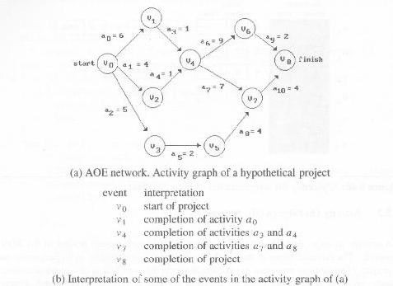
*Figure 6.41:An AOE network(p.310)
concurrent

Slide 90
Application of AOE Network
Evaluate performance
minimum amount of time
activity whose duration time should be shortened
…
Critical path
a path that has the longest length
minimum time required to complete the project
v0, v1, v4, v7, v8 or v0, v1, v4, v6, v8 (18)

Slide 91
other factors
Earliest time that vi can occur
the length of the longest path from v0 to vi
the earliest start time for all activities leaving vi
early(6) = early(7) = 7
Latest time of activity
the latest time the activity may start without increasing the project duration
late(5)=8, late(7)=7
Critical activity
an activity for which early(i)=late(i)
early(7)=late(7)
late(i)-early(i)
measure of how critical an activity is
late(5)-early(5)=8-5=3

Slide 92
earliest, early, latest, late
16
6
v1
v6
16
6
0
a3=1
7
a9=2
a0=6
16
0
6
7
a6=9
18
0
6
10
v4
7
v8
v0
0
14
a1=4
4
7
7
0
14
18
4
a4=1
a7=7
2
a10=4
v2
6
v7
14
0
6
14
a2=5
7
3
a8=4
7
5
14
v3
5
v5
a5=2
8
10
8

Slide 93
Determine Critical Paths
Delete all noncritical activities
Generate all the paths from the start to finish vertex.

Slide 94
Calculation of Earliest Times
earliest[j]
the earliest event occurrence time
latest[j]
the latest event occurrence time
earliest[0]=0
earliest[j]=max{earliest[i]+duration of <i,j>}
i ∈p(j)
v_{k}
a_{i}
v_{l}
early(i)=earliest(k)
late(i)=latest(l)-duration of a_{i}

Slide 95
v_{i1}
v_{i2}
forward stage
v_{j}
.
.
.
v_{in}
if (earliest[k] < earliest[j]+ptr->duration)
earliest[k]=earliest[j]+ptr->duration

Slide 96
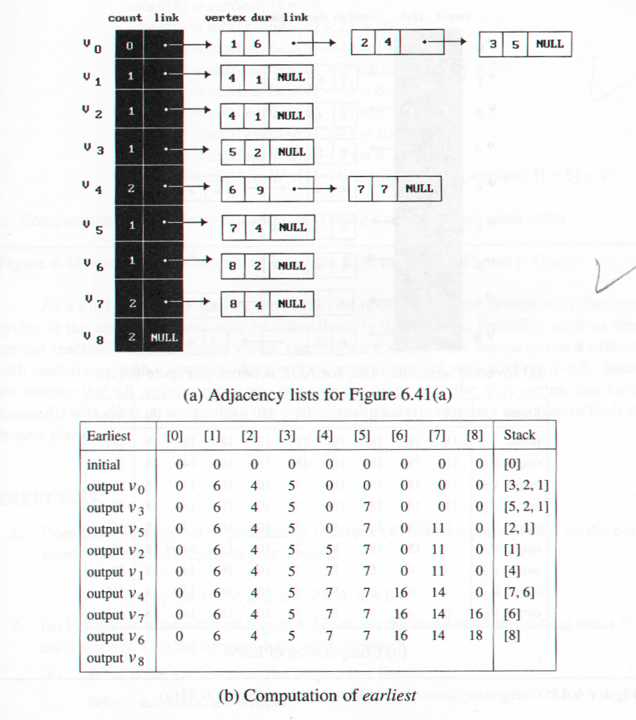
*Figure 6.42:Computing earliest from topological sort (p.313)
v1
v6
v0
v4
v8
v2
v7
v3
v5

Slide 97
Calculation of Latest Times
latest[j]
the latest event occurrence time
latest[n-1]=earliest[n-1]
latest[j]=min{latest[i]-duration of <j,i>}
i ∈s(j)
v_{i1}
v_{j}
v_{i2}
backward stage
.
.
.
v_{in}
if (latest[k] > latest[j]-ptr->duration)
latest[k]=latest[j]-ptr->duration

Slide 98
*Figure 6.43: Computing latest for AOE network of Figure 6.41(a)(p.314)

Slide 99
*Figure 6.43(continued):Computing latest of AOE network of Figure 6.41(a) (p.315)
latest[8]=earliest[8]=18 latest[6]=min{earliest[8] - 2}=16 latest[7]=min{earliest[8] - 4}=14 latest[4]=min{earliest[6] - 9;earliest[7] -7}= 7 latest[1]=min{earliest[4] - 1}=6 latest[2]=min{earliest[4] - 1}=6 latest[5]=min{earliest[7] - 4}=10 latest[3]=min{earliest[5] - 2}=8 latest[0]=min{earliest[1] - 6;earliest[2]- 4; earliest[3] -5}=0 (c)Computation of latest from Equation (6.4) using a reverse topological order

Slide 100
*Figure 6.44:Early, late and critical values(p.316)

Slide 101
*Figure 6.45:Graph with noncritical activities deleted (p.316)
V₁
V₆
a₃
a₆
a₉
a₀
V₀
V₄
V₈
a₇
a₁₀
V₇

Slide 102
*Figure 6.46: AOE network with unreachable activities (p.317)
a₄
V₃
V₄
V₁
a₅
a₆
earliest[i]=0
a₀
a₂
V₀
V₅
a₁
a₃
V₂

Slide 103
*Figure 6.47: an AOE network(p.317)
a₂=3
a₆=4
V₁
V₃
V₆
a₁₂=4
a₀=5
a₇=4
a₃=6
a₁₀=5
a₁₃=2
V₀
a₅=3
V₅
V₈
V₉
finish
start
a₈=1
a₁₁=2
a₁=6
V₂
V₄
V₇
a₄=3
a₉=4

Slide 104
Insertion sort
Void insert ( element e, element a[ ], int i)
{
A[ 0 ] = e;
While( e.key < a[ i ].key)
{
A[ i+1 ]= a[ i ];
i--;
}
A[ i+1 ] = e;
}

Slide 105
Void insertionsort ( element a[ ], int n)
{
Int j;
For (j = 2; j<=n; j++ )
Element temp = a [ j ];
Insert ( temp, a, j-1);
}

Slide 106
Radix sort
Radix sort is the method that many people use when alphabetizing a large list of names
The list of names is first sorted according to the first letter of each name
That is names are arranged in 26 classes, where the first class consists of those names that start with A, the second class consists of those names that start with B and so on

Slide 107
During the second pass, each class is alphabetized according to the second letter of the name and so on

Slide 108
 | a | b | c | d | e | f | G
Def |  |  |  |  |  | Def
Efg |  |  |  |  |  |  | efg
Cde |  |  |  |  | Cde
Aab |  | Aab
Bbc |  |  | Bbc
Abc |  |  | Abc
Ddf |  |  |  |  |  | Ddf
Eef |  |  |  |  |  | Eef
Cce |  |  |  |  | cce
bab |  | bab

Slide 109
 | a | b | c | d | e | f | G
Aab | Aab
Bab | bab
Bbc |  | Bbc
Abc |  | Abc
Cde |  |  |  | Cde
Cce |  |  | Cce
Def |  |  |  |  | Def
Ddf |  |  |  | ddf
Eef |  |  |  |  | eef
efg |  |  |  |  |  | efg

Slide 110
 | a | b | c | d | e | f | G
Aab | aab
Bab |  | Bab
Bbc |  | Bbc
Abc | Abc
Cce |  |  | Cce
Cde |  |  | Cde
Ddf |  |  |  | Ddf
Def |  |  |  | Def
Eef |  |  |  |  | Eef
efg |  |  |  |  | Efg

Slide 111
In the first pass the units digits are sorted.
In the second pass the tens digits are sorted
In the third pass the hundreds digits are sorted

Slide 112
Example
Consider the following sequence
348, 143, 361, 423, 538, 128, 321, 543, 366
input | 0 | 1 | 2 | 3 | 4 | 5 | 6 | 7 | 8 | 9
348 |  |  |  |  |  |  |  |  | 348
143 |  |  |  | 143
361 |  | 361
423 |  |  |  | 423
538 |  |  |  |  |  |  |  |  | 538
128 |  |  |  |  |  |  |  |  | 128
321 |  | 321
543 |  |  |  | 543
366 |  |  |  |  |  |  | 366

Slide 113
input | 0 | 1 | 2 | 3 | 4 | 5 | 6 | 7 | 8 | 9
361 |  |  |  |  |  |  | 361
321 |  |  | 321
143 |  |  |  |  | 143
423 |  |  | 423
543 |  |  |  |  | 543
366 |  |  |  |  |  |  | 366
348 |  |  |  |  | 348
538 |  |  |  | 538
128 |  |  | 128

Slide 114
input | 0 | 1 | 2 | 3 | 4 | 5 | 6 | 7 | 8 | 9
321 |  |  |  | 321
432 |  |  |  |  | 432
128 |  | 128
538 |  |  |  |  |  | 538
143 |  | 143
543 |  |  |  |  |  | 543
348 |  |  |  | 348
361 |  |  |  | 361
366 |  |  |  | 366

Slide 115
Hashing
The time required to search for an key in other searching techniques depends on the number of elements in the collection
Hashing or hash addressing is independent of the number n

Slide 116
Terminology
Hashing will be oriented towards file management
We assume that there is a file F on n records with s set K of keys which uniquely determine the records in F
F is maintained in memory by a table T of m memory locations and L is the set of memory addresses of the locations in T

Slide 117
The general idea is to use the key to determine the address of a record, but care must be taken so that a great deal of space is not wasted
This takes a form of a function H from the set K of keys into the set L of memory addresses.
Such a function H: K→L is called a hash function or hashing function

Slide 118
Hash function may not yield distinct values : it is possible that two different keys k1 and k2 will yield the same hash address. This situation is called collision and some method must be used to resolve it
Hash function
Collision resolutions

Slide 119
Hash functions
Two principle criteria used in selecting a hash function H: K→L are:
The function H should be very easy and quick to compute
The function H should as far as possible, uniformly distribute the hash addresses throughout the set L so that there are minimum number of collisions

Slide 120
Static hashing
Division
Mid-Square
Folding
Digit Analysis

Slide 121
Converting keys into integers
Unsigned int stringToInt (char *key)
{
Int number=0;
While(*key)
Number += *key++;
Return number;
}
Simple additive approach

Slide 122
Unsigned int StingToInt ( char *key)
{
Int number = 0;
While ( *key)
{
Number += *key++;
If(*key) number +=((int) *key++) <<8;
}
Retunr number;
}

Slide 123
Overflow handling
Open addressing
Chaining
Four open addressing methods
Linear probing or linear open addressing
Quadratic probing
Rehashing
Random probing

